Slide 1
PHP: Interfaces, Abstract Classes, Polymorphism
PHP: Understanding and Applying Polymorphism in PHP

Slide 2
Continue From Previous Lecture..:
(We Continue from
PHP Functions)
Function Overriding
Public Members
Private Members
Protected Members

Slide 3
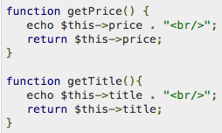
Function Overriding
Function definitions in child classes override definitions with the same name in parent classes. In a child class, we can modify the definition of a function inherited from parent class.
In the following example getPrice and getTitle functions are overridden to return some values.
Resource: https://www.tutorialspoint.com/php/php_object_oriented.htm

Slide 4
Functions: Public Members
Unless you specify otherwise, properties and methods of a class are public. That is to say, they may be accessed in three possible situations −
From outside the class in which it is declared
From within the class in which it is declared
From within another class that implements the class in which it is declared
Till now we have seen all members as public members. If you wish to limit the accessibility of the members of a class then you define class members as private or protected.
Resource: https://www.tutorialspoint.com/php/php_object_oriented.htm

Slide 5
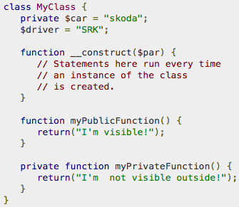
Functions: Private Members
By designating a member private, you limit its accessibility to the class in which it is declared. The private member cannot be referred to from classes that inherit the class in which it is declared and cannot be accessed from outside the class.
A class member can be made private by using private keyword in front of the member.
When MyClass class is inherited by another class using extends, myPublicFunction() will be visible, also the $driver will be visible. The extending class will not have any awareness of or access to myPrivateFunction and $car, because they are declared as private.
Resource: https://www.tutorialspoint.com/php/php_object_oriented.htm
Notes:
Resource: https://www.tutorialspoint.com/php/php_object_oriented.htm

Slide 6
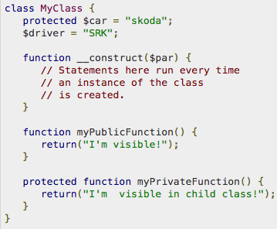
Functions: Protected Members
A protected property or method is accessible in the class in which it is declared, as well as in classes that extend that class.
Protected members are not available outside of those two kinds of classes. A class member can be made protected by using protected keyword in front of the member.
Here is different version of MyClass −
Resource: https://www.tutorialspoint.com/php/php_object_oriented.htm
Notes:
Resource: https://www.tutorialspoint.com/php/php_object_oriented.htm

Slide 7
Polymorphism
What is Polymorphism?
Polymorphism describes a pattern in object oriented programming in which classes have different functionality while sharing a common interface.
An integral part of polymorphism is the common interface. There are two ways to define an interface in PHP: interfaces and abstract classes. Both have their uses, and you can mix and match them as you see fit in your class hierarchy.
Resource: https://code.tutsplus.com/tutorials/understanding-and-applying-polymorphism-in-php--net-14362

Slide 8

Interfaces
An interface is similar to a class except that it cannot contain code. An interface can define method names and arguments, but not the contents of the methods. Any classes implementing an interface must implement all methods defined by the interface. A class can implement multiple interfaces.
An interface is declared using the 'interface' keyword:
Resource: https://code.tutsplus.com/tutorials/understanding-and-applying-polymorphism-in-php--net-14362

Slide 9

Interfaces…
Interface can be attached to a class using the 'implements' keyword (multiple interfaces can be implemented by listing them separated with commas):
Resource: https://code.tutsplus.com/tutorials/understanding-and-applying-polymorphism-in-php--net-14362

Slide 10
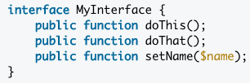
Interfaces…
Methods can be defined in the interface just like in a class, except without the body (the part between the braces):
All methods defined here will need to be included in any implementing classes exactly as described. (read the code comments in next slide)
Resource: https://code.tutsplus.com/tutorials/understanding-and-applying-polymorphism-in-php--net-14362

Slide 11
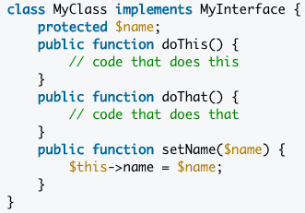
Interfaces…
Resource: https://code.tutsplus.com/tutorials/understanding-and-applying-polymorphism-in-php--net-14362

Slide 12

Abstract Class
An abstract class is a mix between an interface and a class. It can define functionality as well as interface (in the form of abstract methods).
Classes extending an abstract class must implement all of the abstract methods defined in the abstract class.
An abstract class is declared the same way as classes with the addition of the 'abstract' keyword:
Resource: https://code.tutsplus.com/tutorials/understanding-and-applying-polymorphism-in-php--net-14362

Slide 13

Abstract Class…
Abstract class is attached to a class using the 'extends' keyword:
Resource: https://code.tutsplus.com/tutorials/understanding-and-applying-polymorphism-in-php--net-14362

Slide 14
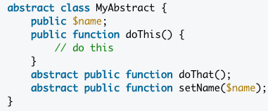
Abstract Class…
Regular methods can be defined in an abstract class just like how we define then in a regular class, we have to use the 'abstract' keyword.
Abstract methods behave just like methods defined in an interface, and must be implemented exactly as defined by extending classes.
Resource: https://code.tutsplus.com/tutorials/understanding-and-applying-polymorphism-in-php--net-14362

Slide 15
Useful 4 Steps to remember
STEP 1: Identify the problem you have
STEP 2: Define your Interface
STEP 3: Create your implementation
STEP 4: Use your implementation
Notes:
Polymorphism is an elegant way to escape from ugly conditional statements in your OOP code
Polymorphism helps us keeping our components separate, and is an integral part of many design patterns

Slide 16
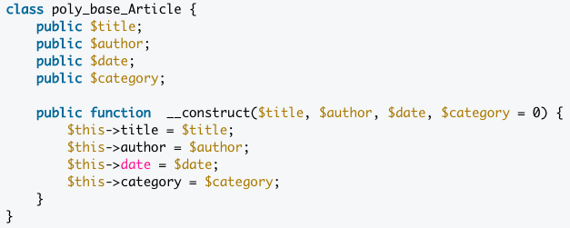
Step1: Identify the problem
Example: Let's imagine that you have an Article class that is responsible for managing articles on your website. It contains information about an article, including the title, author, date, and category. Here's what it looks like:
Note: The example classes in this tutorial use the naming convention of "package_component_Class." This is a common way to separate classes into virtual namespaces to avoid name collisions.
Resource: https://code.tutsplus.com/tutorials/understanding-and-applying-polymorphism-in-php--net-14362

Slide 17
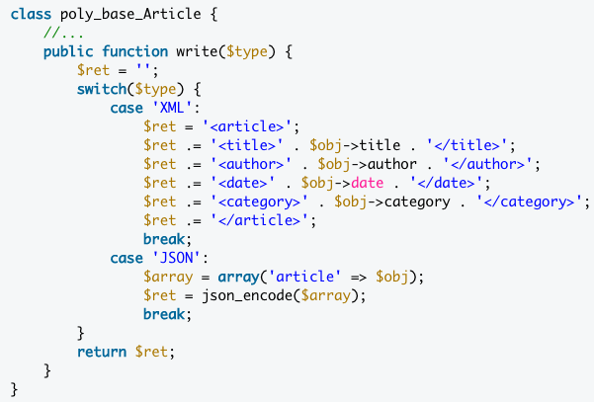
Step1: Identify the problem..
Now you want to add a method to output the information into different formats, such as XML and JSON. You might be tempted to do something like this:
With this in mind, conditional statements should be a red flag indicating that your class is trying to do too many different things. This is where polymorphism comes in.

Slide 18
Step1: Identify the problem..
Now you want to add a method to output the information into different formats, such as XML and JSON. You might be tempted to do something like this:
With this in mind, conditional statements should be a red flag indicating that your class is trying to do too many different things. This is where polymorphism comes in.
In this example, it is clear that there are two tasks presented: managing articles and formatting their data.
We will refactor our formatting code into a new set of classes and discover how easy it is use polymorphism.

Slide 19

Step2: Define the Interface
The first thing we should do is define the interface. It is important to think hard about your interface, because any changes to it may require changes to calling code. In our example, we'll be using a simple interface to define our one method:
We have defined a public write() method that accepts an Article object as an argument. Any classes implementing the Writer interface will be sure to have this method.
Tip: If you want to restrict the type of arguments that can be passed to your functions and methods, you can use type hints, as we've done in the write() method; it only accepts objects of type poly_base_Article. Unfortunately, return type hinting is not supported in current versions of PHP, so it is up to you to take care of return values.
Notes:
Tip: If you want to restrict the type of arguments that can be passed to your functions and methods, you can use type hints, as we've done in the write() method; it only accepts objects of type poly_base_Article. Unfortunately, return type hinting is not supported in current versions of PHP, so it is up to you to take care of return values.

Slide 20
Resources
Read the following Article/Tutorial for the Step 3, 4
https://code.tutsplus.com/tutorials/understanding-and-applying-polymorphism-in-php--net-14362

